Slide 1
Where to live in Milwaukee COunty
IBM DATA SCIENCE CAPSTONE
M. Pierce

Slide 2
Introduction:
Choosing where to live can be a difficult decision. There are many factors that go into choosing a location to live. The audience for this project is young professionals, with no children, starting their careers in the city of Milwaukee, Wisconsin. This project focuses on Milwaukee County and the cities within. Each city in the county is unique and different and has different offerings. This project will explore locations, clusters, population, and venues. Once cleaned and visualized the data can be used for an individual to make decisions where to start looking to live.

Slide 3
DATA
The data location, population, and density came from https://simplemaps.com/data/us-cities. This data set included State, county, city, lat/long, density, and time zone information. This was used to highlight and visualize the locations in relationship to the City of Milwaukee and create k-means clusters. Foursquare data was used to gather information on all venues near the cities/clusters. The venues were sorted by frequency and top 10 lists were created for each city in each cluster.

Slide 4
METHODS
The process started by segmenting the national city data. The data included all cities, counties and states. Since this project was only concerned with Milwaukee County, Wisconsin the data needed top be cleaned and segmented.
Once the columns were standardized for this exercise, I dropped unneeded data.
After removing unnecessary columns, using folium, I displayed only cities and counties in Wisconsin. This was still too much data to work with
I created a new data frame that included only cities in Milwaukee County
Once prepared, the data can now be enriched by using the foursquare API. The following is a top 10 venues for each city in the county.

Slide 5
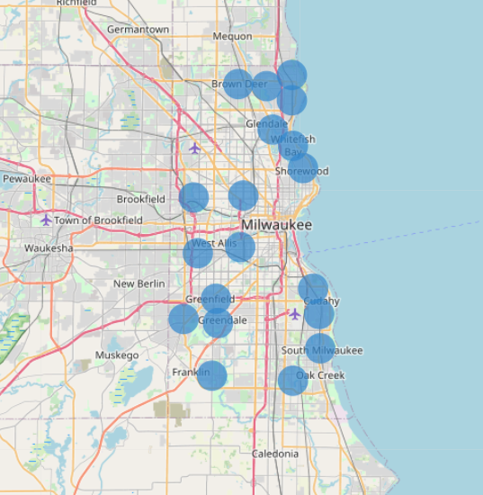
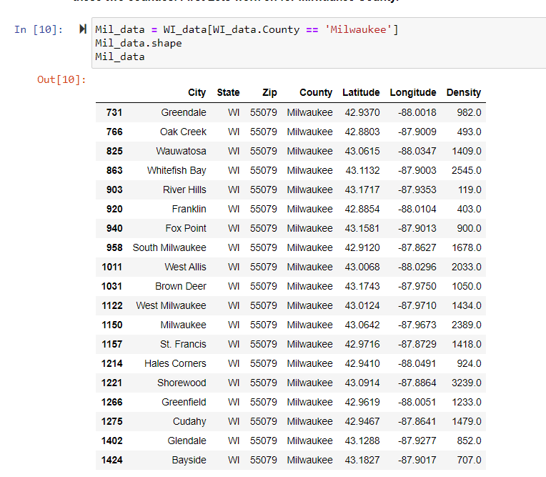
Data Exploration and visualization

Slide 6
Results:
Once the foursquare data was gathered and encoded, k-means clustering was used to group the cities into 4 clusters.
Each cluster was then output to include the top 10 venues to aid the individual in choosing a location.

Slide 7
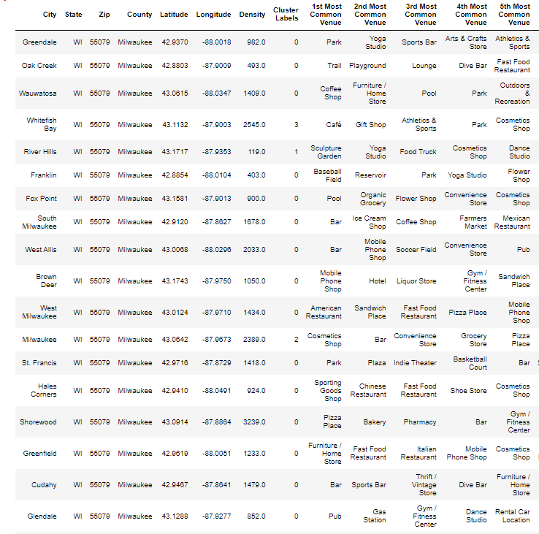
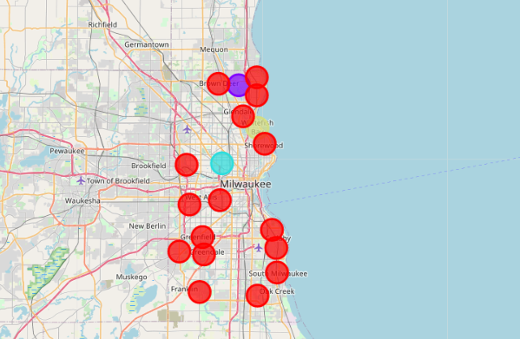
Clustering Results

Slide 8
Discussion
When the clusters are examined in tabular form, types of venues that are important to the individual can be identified. This is not the only thing that needs to be considered, however. The visualization of the unique clusters on the maps also aid the individual in choosing their ideal location.
Once narrowed down further and a location based on cluster is chosen, more data can be included, such as crime data, housing cost, traffic data etc. This is essentially the first step in choosing a place in Milwaukee to relocate.

Slide 9
Conclusion
Large data sets can be used to solve complex problems. This simple exercise uses two separate sources and types of data to aid in a personal decision. The set of data could be increased to provide more information and clarity for the individual.

